Slide 1
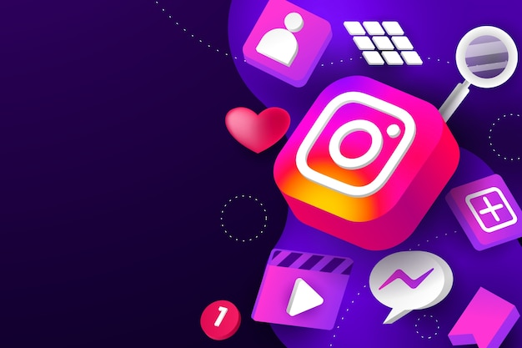
Social Media Analysis
Database of ig_clone
-By Moumita Samaddar

Slide 2


Introduction
Instagram is a premier global photo and video-sharing social media platform owned by Meta Platforms. Conceived by Kevin Systrom and Mike Krieger, it launched in October 2010 as an iOS exclusive. Today, it boasts over two billion monthly active users and has transformed from a simple photo filter app into a massive cultural and business powerhouse.

Slide 3
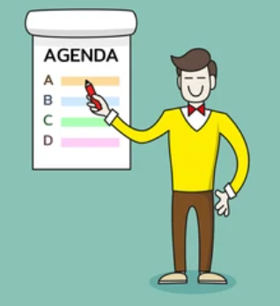
Agenda
1. Problem Statement
2. Data Description
3. Objective Key Metrics and Visualizations
4. Subjective Question for Insights

Slide 4

Problem Statement
You are hired as a data analyst at Meta and asked to collaborate with Marketing team. Marketing teams wants to leverage Instagram's user data to develop targeted marketing strategies that will increase user engagement, retention, and acquisition. Provide insights and recommendations to address the following objectives.

Slide 5
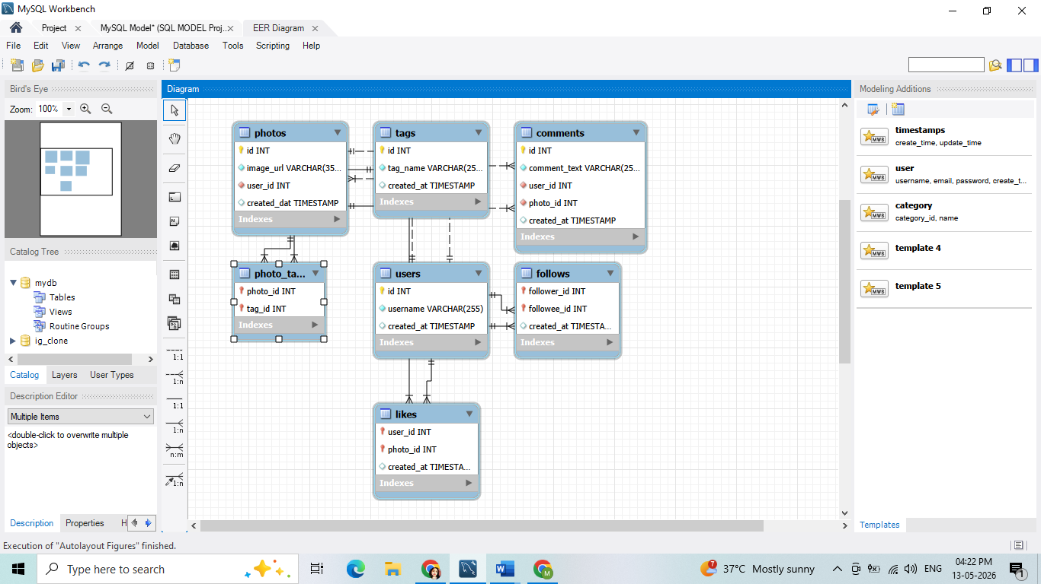
Database Schema

Slide 6
Data Description
Instagram User Interaction Dataset Overview
This dataset captures Instagram user behavior and interactions to analyze engagement, content trends, and relationships.
Data Attributes Explained:
username: Unique user handle.
user_id: Unique user identifier.
photo_id: Unique photo identifier.
created_at: Timestamp of the interaction.
comment_id: Unique comment identifier.
comment_text: Text of the comment.
follower_id: ID of the user following someone.
followee_id: ID of the user being followed.
tag_id: Unique photo tag identifier.
image_url: Direct link to the image.
Data Link: Link

Slide 7







Data Overview
7 related tables containing Instagram post data
100
users
7623 follows
257 photos posts
501 photo_tags
8782 likes
on photos
7488 comments
21 tags

Slide 8
Data Exploration Approach
Identify the database schema
Data Cleaning in MySQL Workbench
Identified metrics to find high engagement users
Ran queries sing CTEs and other SQL concepts to fetch relevant data
Generated insights using SQL queries
Made recommendations to optimize Instagram marketing

Slide 9
Instagram Data Analysis with SQL
Use JOINs to link various tables like users, photos, likes, etc.
Use of aggregate functions like count and average with group by clause.
Use of order by clause to sort the users or photos based on certain count (for example, sorting photos with highest number of likes).
Use CTEs and sub-queries for simplification of complex queries to fetch metrics like count, average, likes, comments and so on across different tables.
Use of Window functions like rank() and dense_rank() to rank the top engagement users.

Slide 10
User Classification
📊 Insights
Active (30%): 30/100 users are highly engaged.
Moderately Active (34%): 34/100 users are medium-engaged.
Inactive (36%): 36/100 users are low-engaged.
🎯 Recommendations
Implement loyalty programs or 'Super User' status to sustain high engagement levels.
Deploy a 'We Miss You' re-engagement campaign via push notifications or targeted email offers.

Slide 11

Most Loyal Or Valuable Users
Users with high engagement rates can be considered loyal or most valuable. As per the previous slide, the following valuable users can also be used as brand ambassadors to boost the reach of future ad campaigns or targeted contents.
Clint27
Delfina_VonRueden68
Aurelie71
Jaime53
Donald.Fritsch
Eveline95
Cesar93

Slide 12
Top Users with Highest Engagement
📊 Insights
The top 10 influencers drive most platform activity.
High comment-to-like ratios identify active contributors who boost user retention.
🎯 Recommendations
Launch a creator program for the top 5 users to boost retention and content production.
Analyze content formats vs. engagement to identify and replicate top-performing trends.

Slide 13
Cohort Analysis (Joining Year Insight)
Users who joined in 2016 average 64.01 engagements per post, slightly outperforming the 2017 cohort.
This minimal difference indicates consistent engagement behavior across generations and a stable platform experience for both early and newer adopters.
Engagement efficiency remains stable across cohorts, reflecting consistent user interaction quality.

Slide 14
Photos Segmentation Analysis
📊 Insights:
0 posts: Inactive/New.
1–3 posts: Active, low participation.
4–6 posts: Engaged, growing.
7+ posts: Small, high-value group
🎯 Recommendations:
0 posts: Encourage first upload with tips and rewards.
1–3 posts: Boost activity using gamification and streaks. 4–6 posts: Increase visibility with spotlights and incentives.
7+ posts: Reward with badges and ambassador perks.

Slide 15
Likes Segmentation Analysis
📊 Insights
Zero Likes → Inactive users.
Medium (51–100) → Majority group (~5.3K likes).
High (>100) → Strong contributors (~3.4K likes).
🎯 Recommendations
Zero → Onboarding prompts, first-like rewards.
Medium → Gamification (badges, streaks, leaderboards).
High → Exclusive perks, early access, recognition.
👉 Focus: Shift medium → high & cut inactivity.

Slide 16
Comments Segmentation Analysis
📊 Insights
Users split into Zero, Low (1–50), Medium (51–100), High (>100) comments.
Most users are Medium (~4,098) and High (~3,341) → strong engagement.
Very few in Zero/Low → minimal inactivity.
🎯 Recommendations
Zero/Low → Re-engage with prompts or tutorials.
Medium → Gamify & recognize to move them higher.
High → Reward with perks, early access, ambassador roles.
👉 Focus: Reduce inactivity, uplift medium users, retain high contributors.

Slide 17
User Engagement By Weekday
📊 Insights:
Peak: Thursday (1,727) and Wednesday (1,571).
Steady: Friday (1,430) and Monday (1,354).
Moderate/Low: Sunday (1,198), Tuesday (1,144), and Saturday (1,120).
🎯 Recommendations:
Focus major content and campaigns on Thursday and Wednesday. Use Monday and Friday for reminders or promotions.
Keep Saturday and Tuesday light with polls or stories, and experiment with Sunday evening posts to engage weekend users.

Slide 18
Peak Engagement Time
📊 Insights:
Peak: 5 PM (1,120) and 11 PM (1,249).
Steady: 1 PM to 11 PM (strongest 3 PM–9 PM).
Low: Late night and early morning (12 AM–10 AM).
🎯 Recommendations:
5 PM – 11 PM: Schedule main posts for maximum visibility.
7 PM – 9 PM: Run high-impact campaigns, ads, or live sessions.
11 PM – 12 AM: Test exclusive content drops.
6 AM – 10 AM: Avoid posting due to low engagement.

Slide 19
Top Engaging Tags
📊 Insights:
High: Food and scenic content.
Medium: Lifestyle and visual aesthetics.
Low: Event tags (e.g., party, concert).
🎯 Recommendations:
Optimize Strategy: Blend high and mid-performing tags to expand reach.
Refine Performance: Revise or phase out low-engagement content.
Diversify Tags: Use a balanced tag mix to maximize visibility and avoid saturation.

Slide 20
Strategy to Re-engage Inactive Users
Send notifications about friends’ recent activities or anniversaries of their account creation.
Introduce challenges or streak rewards to encourage regular activity.
Recommend trending hashtags or content topics .
Offer discounts, free features, or additional storage for becoming active again.
Engage users through surveys to understand why they became inactive and address their concerns.

Slide 21
Recommendations based on Instagram Data Insights
Post consistently during peak engagement hours to maximize visibility and interactions.
Research trending hashtags in one’s niche and experiment with them to reach new users.
Analyze what drives the 63.31% engagement rate: visuals, captions, hashtags, or interactivity.
With an average of 3 tags per post, there's room to tag more relevant accounts, brands, or collaborators.

Slide 22
Conclusion
Re-engage Inactive Users: Target them with personalized content and notifications.
Leverage Trending Hashtags: Monitor and use them strategically to boost content discovery.
Prioritize Reels: Encourage reel creation around trends to capture younger and newer audiences.
Align Ads with Trends: Keep ad campaigns current to improve relevance and response rates.

Slide 23
THANK YOU

